Slide 1
Public Opinion Analysis
for Government Policy Makers
Group – 16
Gaurav Deswal, Jayshil Shah, Amit Prajapati, Rohit Gupta, Ankur Bhoi, Kirtan Shah

Slide 2
Problem Statement and Motivation
We aim to develop an Information Retrieval System (IRS) web application, called ‘Public Opinion Analysis for Government Policy Makers, tailored for government officials responsible for public policy.
This tool will gather public sentiment and feedback from Reddit regarding implemented policies.
With the help of LLM using Retrieval Augmented Generation (RAG) techniques, it will analyze the Reddit comments, extracting public ideas and concerns aiding in policy refinement and development.
Our project serves as a vital link between the public and policymakers, gathering and delivering the concerns and problems voiced by people on Reddit directly to government officials. By doing so, we bridge the gap between citizens and policymakers, facilitating the resolution of issues related to government policies.

Slide 3
Literature Review
1. An Approach towards Comprehensive Sentimental Data Analysis and Opinion Mining. - IEEE
The paper introduces a method for analyzing sentiments and opinions automatically.
It uses tools like the Stanford Parser and SentiWordNet to process and score sentiments, presenting results
visually with the Google Chart API.
2. Social Media Web Scraping Using Social Media Developers API and Regex.
The study suggests a web scraping technique using Facebook and Twitter APIs along with regular expressions to
handle overload and redundancy in social media.
The research underscores the significance of web scraping in data extraction and mentions relevant tools
3. Public Opinion Mining For Effective Policy Making
The paper proposes a method to assess public sentiment on government policies such as Ganga rejuvenation and state
separation through online forums.
The system includes steps like user registration, opinion gathering, sentiment analysis, and visualizing results, aiming to
improve democratic engagement and policymaking.
4. Mining Public Opinion on Indian Government Policies Using R
The paper explores public sentiment on Indian Government policies using Twitter data, employing standard methods in R
programming for data processing and sentiment analysis.
Focusing on policies like Article 370 and the New Motor Vehicle Act 2019, it offers insights into how the public perceives
government initiatives.

Slide 4
Novelty
Unlike existing approaches that mainly analyze sentiment, our project goes beyond by extracting actionable insights from public comments on Reddit. We not only provide sentiment statistics but also provide public ideas and the most frequently occurring concerns directly relevant to government policies offering our end-user i.e. policymakers valuable real-time feedback for informed decision-making.

Slide 5
Methodology
User Input and Policy Selection:
Users select a policy name from a dropdown menu on the web application interface. The selected policy name is used query to fetch relevant comments from reddit. Implement a smart autocomplete feature to assist users in accurately selecting policy names. This feature suggests complete policy names as user’s type, improving the accuracy of policy selection and reducing the risk of confusion.
Data Collection from Reddit :
Utilize reddit's API to fetch public posts and comments related to the selected policy. Gather a sufficient number of comments to ensure comprehensive coverage of public opinions.
Policy Context Retrieval:
Retrieve context and details about the selected policy from trusted websites or sources. This information will provide background and context for understanding the policy being discussed in the reddit comments.

Slide 6
Methodology
Language Model Evaluation with RAG:
Utilize gemini, an LLM with RAG, to analyze comment relevance to the selected policy. RAG combines retrieval and generation, leveraging pre-existing policy context and generating responses. Evaluate semantic relevance to filter irrelevant comments, enhancing efficiency. RAG offers computational efficiency and comprehensive understanding, crucial for large-scale social media datasets like reddit. Perform sentiment analysis on filtered comments to gauge public sentiment towards the policy.
Policy Generation from Comments :
Aggregate insights from the analyzed comments to generate new policies or refine existing ones. Identify recurring themes, concerns, or suggestions expressed in the comments. Use these insights to inform policymaking decisions and potentially adapt policies based on public feedback.

Slide 7
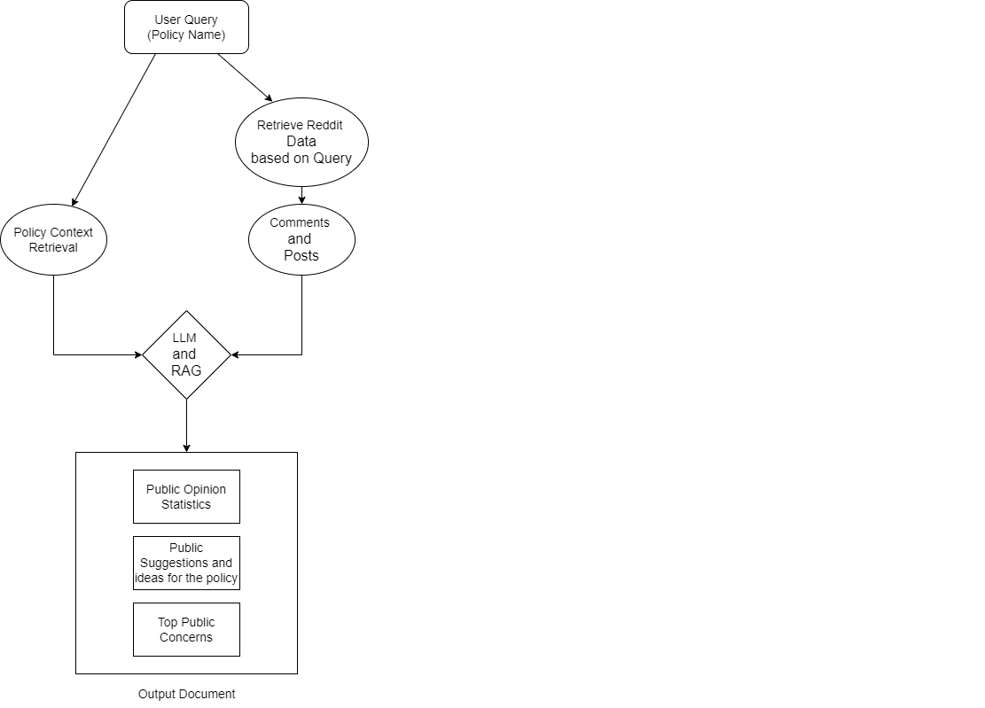
Proposed Solution

Slide 8
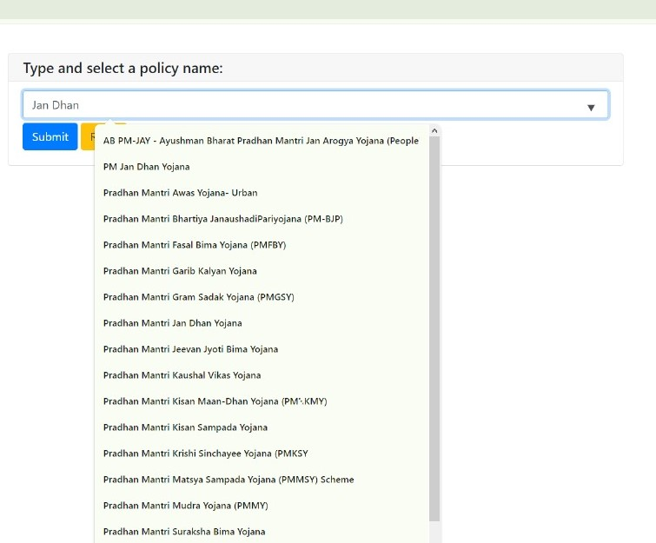
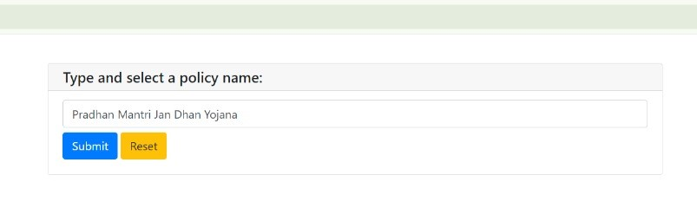
Results

Slide 9
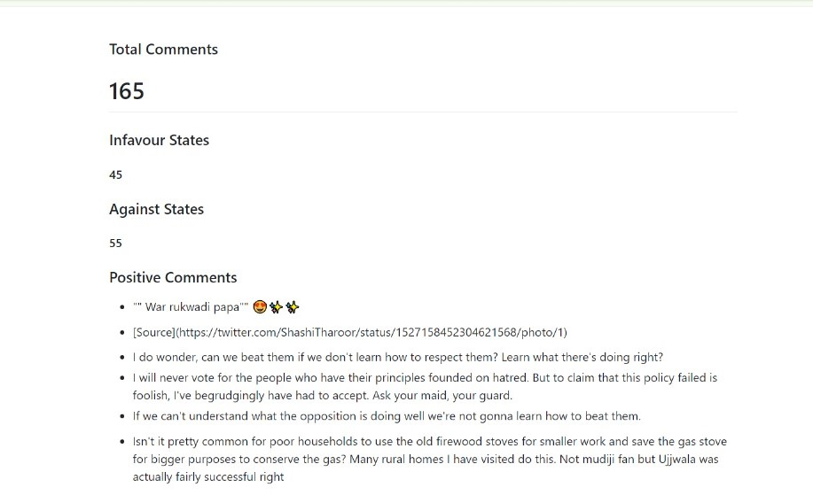
Output

Slide 10
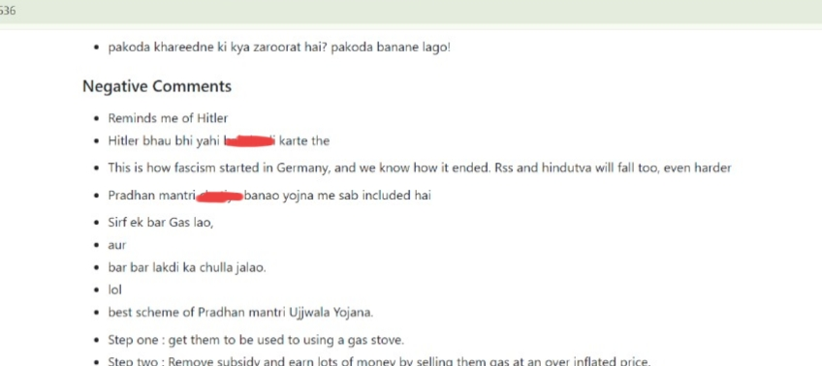

Slide 11
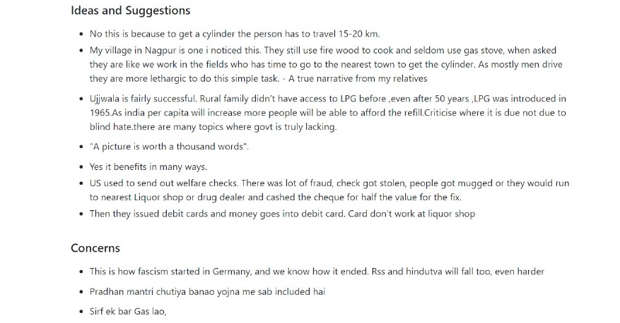

Slide 12
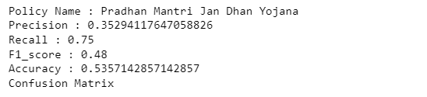
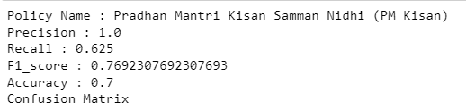
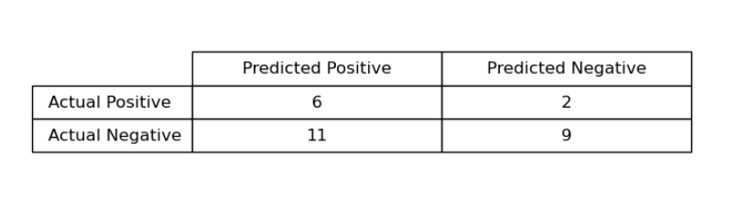
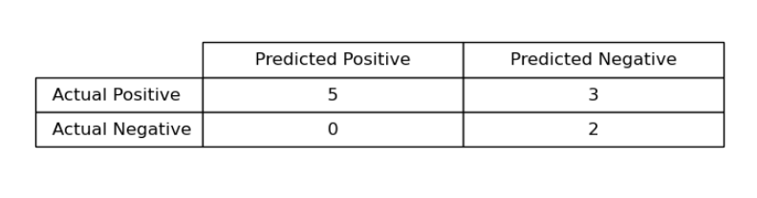
Evaluation
(1)
(2)
Confusion Matrix
Confusion Matrix

Slide 13
Challenges and Limitations
Identifying Spam Comments: Distinguishing between genuine public opinions and spam/bot-generated comments poses a significant challenge. Developing robust algorithms to filter out spam while ensuring authentic public feedback is essential for accurate analysis.
Scalability and Real-Time Processing: Processing a large volume of comments in real-time to provide timely insights to policymakers requires scalable infrastructure and efficient algorithms. Ensuring the system can handle varying levels of demand without sacrificing performance is essential.
Limited Policy Coverage on Reddit: The effectiveness of the system heavily relies on the availability of relevant policy data and discussions on Reddit. Some policies may not generate sufficient discussion or may be discussed in niche communities, limiting the breadth of coverage and insights provided by the application.

Slide 14
Conclusion
The project successfully analyzed public opinion on government policies using reddit comments, showcasing the potential of natural language processing and sentiment analysis. Performance varied across policies, with pradhan mantri jan dhan yojana exhibiting moderate accuracy and pradhan mantri kisan samman nidhi (PM kisan) demonstrating higher metrics. These results highlight the effectiveness of leveraging social media data to gauge public sentiment and guide policy decisions. It also gives the top concerns and ideas on the given by public on the selected policies. Future work can focus on refining the system's precision and recall for more nuanced policy evaluation.

Slide 15
Thank You !!

